Slide 1
Components of a time series
Time series decomposition
1

Slide 2


Contents
BREAKING TIME SERIES INTO COMPONENTS
WHY IS THIS USEFUL?
2

Slide 3
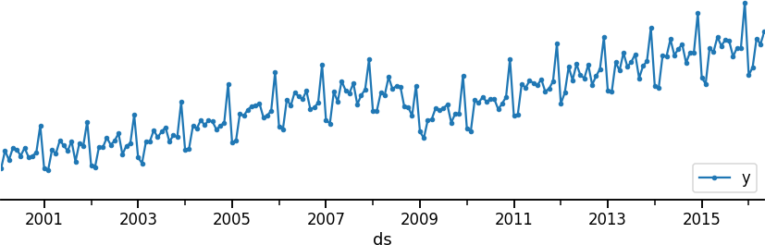
Time series components
Time series can sometimes be broken into individual components. Typically a trend, seasonal, and a residual component
y(t) -> trend(t) , seasonal(t) , residual(t)

Slide 4
Time series components: Trend
Trend: A trend is a long-term increase or decrease of the baseline of the time series, not necessarily linear.

Slide 5
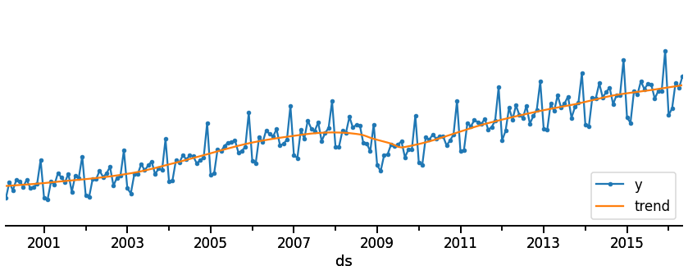
Time series components: Trend
Trend: A trend is a long-term increase or decrease of the baseline of the time series, not necessarily linear.
Baseline (Level): The overall average value around which the fluctuations occur. This is the central tendency of the series.

Slide 6
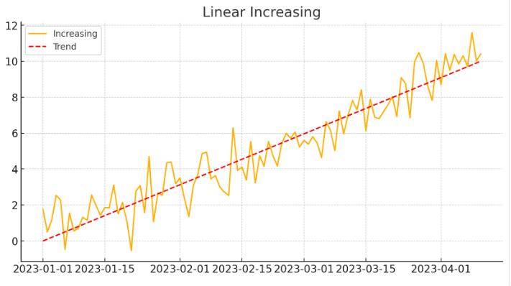

Slide 7
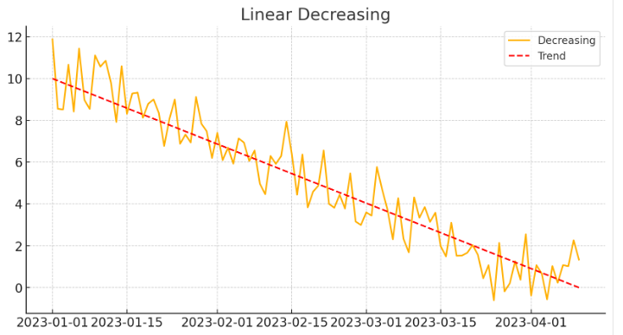

Slide 8
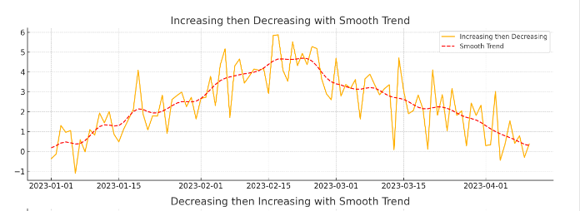
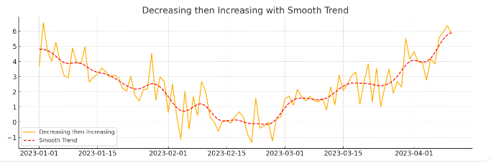

Slide 9
Time series components: Seasonality
Seasonality: A fixed periodic pattern in the time series. Patterns relate to seasonal factors such as time of the year or day of week.
Examples: Black Friday, Christmas, School holidays, etc.

Slide 10
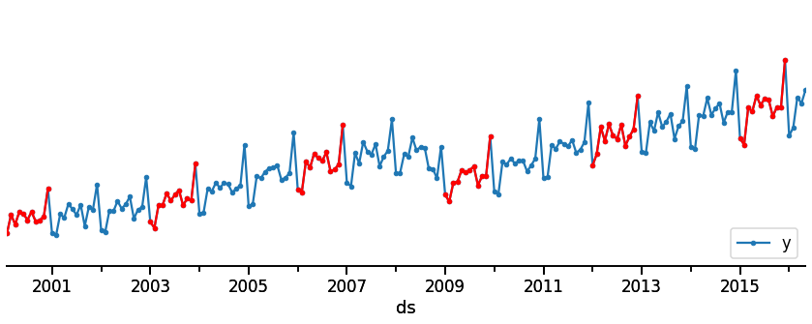
Time series components: Seasonality
Let us highlight some years here to illustrate yearly seasonality (i.e., a repeating pattern that occurs each year)

Slide 11
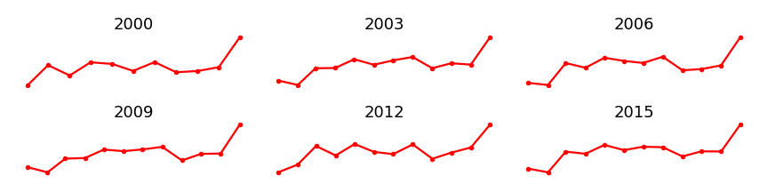
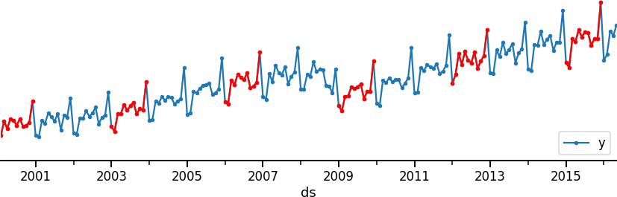
Time series components: Seasonality

Slide 12
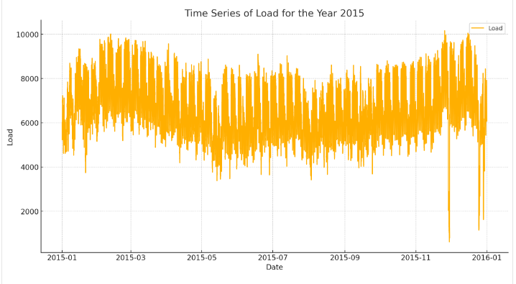
Seasonality

Slide 13
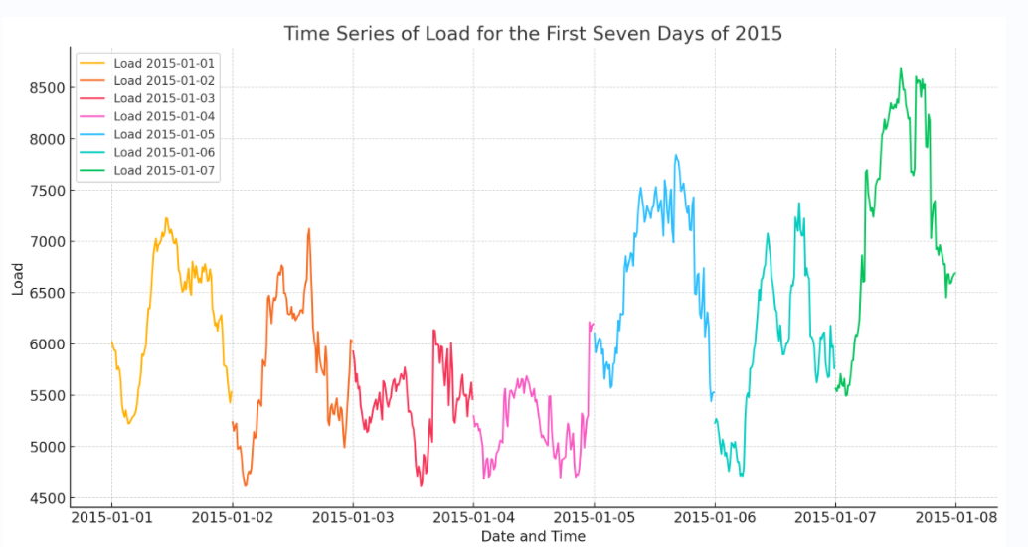
Seasonality
January 1 (Thursday): It is a holiday (New Year's Day), which might show a different load pattern compared to regular weekdays.
January 2 (Friday): A regular weekday, which should show normal working day load patterns.
January 3 (Saturday): A weekend, which typically has lower and more variable load compared to weekdays.
January 4 (Sunday): Another weekend day, which should have similar characteristics to Saturday.

Slide 14
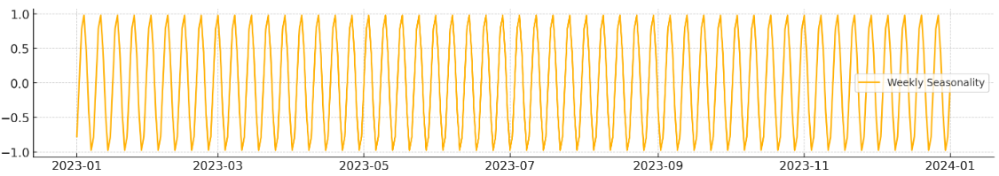
Weekly Seasonality

Slide 15
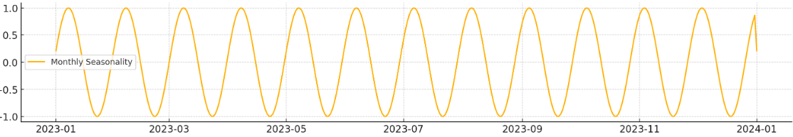
Monthly Seasonality

Slide 16
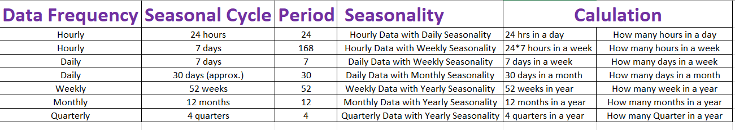
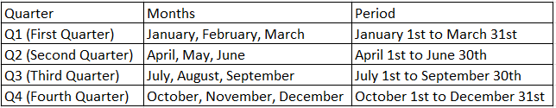
Seasonality

Slide 17
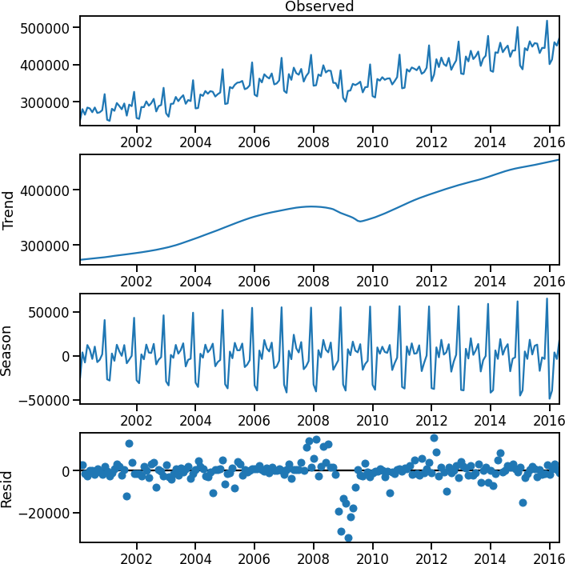
Time series components: Residual
The residual (aka. remainder, irregular) component is everything leftover after subtracting the other components

Slide 18
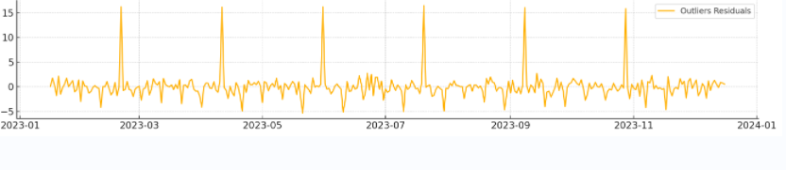
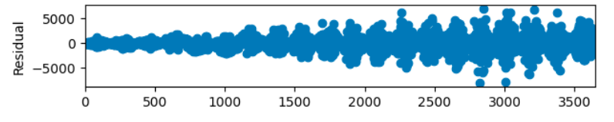
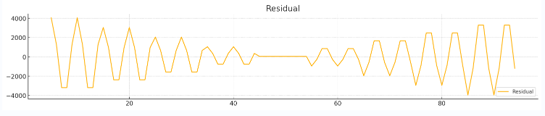
Residual

Slide 19
Residuals
Random Noise: Purely random variations that cannot be attributed to trend, seasonality, or other systematic factors.
Trend: Long-term progression or systematic movement in the data. If the trend is not adequately modeled, it will appear in the residuals.
Seasonality: Regular, repeating patterns within fixed periods. If seasonality is not correctly accounted for, it will show up in the residuals.
Cyclic Patterns: Long-term oscillations not of fixed period. These can be mistaken for trend or seasonality if not correctly identified.
Outliers: Sudden, unexpected changes or spikes in the data. These can be caused by external events and often appear prominently in the residuals.
Structural Breaks: Changes in the underlying process generating the time series, such as policy changes, economic shifts, or system upgrades.
Model Misspecification: Incorrect assumptions or parameters in the decomposition model can lead to residuals capturing unmodeled aspects of the series.
External Factors: Events or influences outside the data’s primary domain, such as economic crises, natural disasters, or major policy changes.
Measurement Errors: Errors in data collection or recording that introduce anomalies or inaccuracies into the series.

Slide 20
Time series components: Bringing it back together
y(t) = trend(t) + seasonal (t) + residual(t) y(t) = trend(t) x seasonal (t) x residual(t)

Slide 21




Why is decomposition useful?
Exploratory data analysis: To answer questions such as “what was the impact of an ad campaign once we account for seasonality?”
Pre-processing: Useful for identifying outliers and can be used to impute outliers and missing data
Feature engineering: Can derive features from the components to use as inputs in machine learning models
Forecasting: Forecast the components and aggregate to produce the final forecast

Slide 22
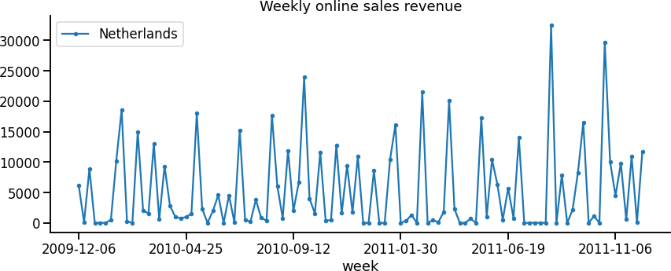
Decomposition is not always possible
Not all time series can be easily broken down into components

Slide 23
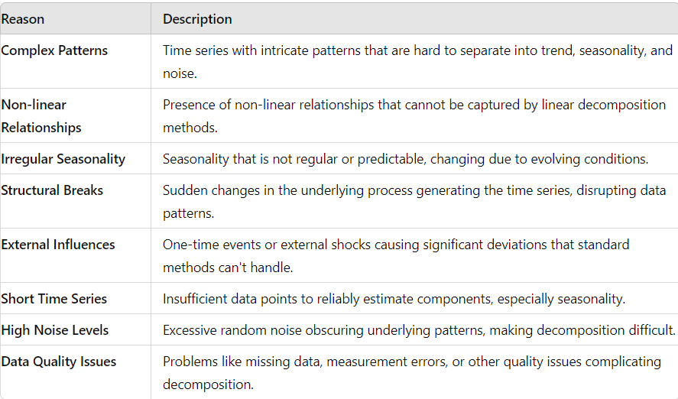
Decomposition is not always possible

Slide 24
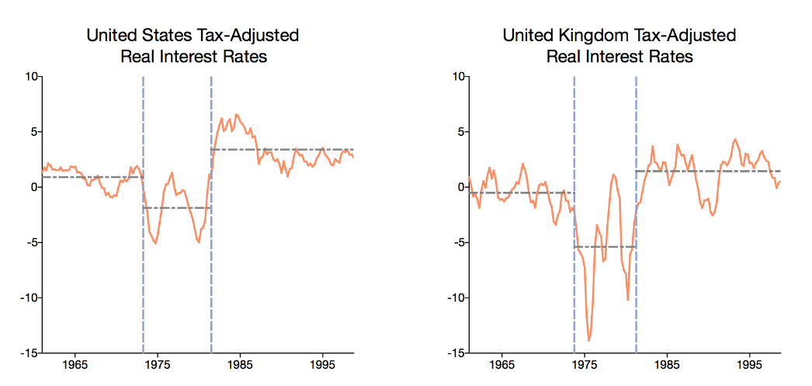
Decomposition is not always possible - structural break

Slide 25
Time series can be decomposed into components
Summary
Trend, seasonality, and a residual component is the most common
Decomposition is used in multiple ways including EDA, feature engineering, preprocessing, and forecasting
13

Slide 26
Time series components: Seasonality
seasonal(t + T) = seasonal(t)
T is the period of the seasonality (e.g., 1 year)
14

Slide 27
Day | Sales
Mon | 100
Tue | 120
Wed | 150
Thu | 130
Fri | 200
Sat | 250
Sun | 180
Mon | 100
Tue | 120
Wed | 150
Thu | 130
Fri | 200
Sat | 250
Sun | 180
$$Seasonal\left(t\right)=Seasonal(t+7)$$
Sales on Monday (Day 1) = Sales on the next Monday (Day 8) = 100
Sales on Tuesday (Day 2) = Sales on the next Tuesday (Day 9) = 120
It is not necessary to have the exact same numbers for the sales on corresponding days of different weeks to observe seasonality.
Seasonality refers to patterns that repeat at regular intervals, and these patterns can involve fluctuations rather than exact repetitions.
The key aspect of seasonality is the presence of a repeating pattern over the specified period (in this case, 7 days for weekly seasonality), not necessarily the exact same values.

Slide 28
White noise
Time series decomposition
1

Slide 29

Contents
WHAT IS WHITE NOISE?
ANALYSIS OF RESIDUALS
2

Slide 30
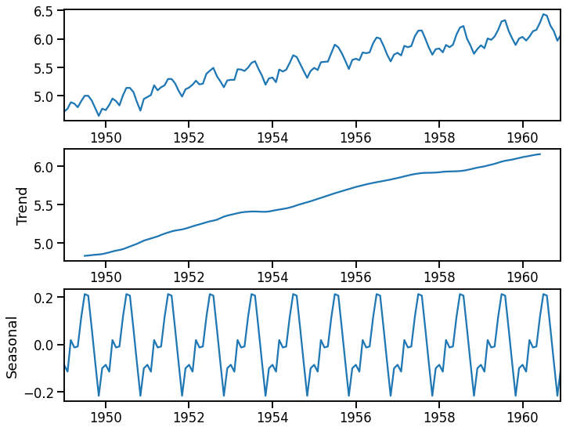
Motivation
Air passengers
We will want to show how tools we introduce later (e.g., lag plots, correlation functions) behave for time series with various properties.
y
Two properties already covered so far are trend and seasonality.
we discuss a new property that can characterise the behaviour of a time series: white noise.
Time

Slide 31
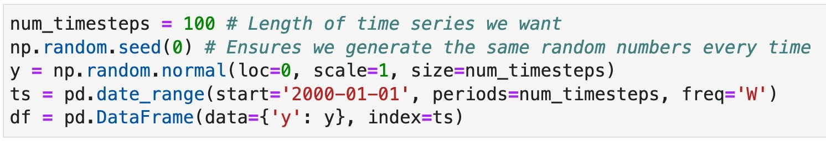
White noise
Let’s generate a time series 𝑦_{𝑡} by taking a random sample from any distribution of our choice (e.g., Normal distribution with zero mean and unit variance aka 𝑁(0,1)) at each time step 𝑡 .

Slide 32
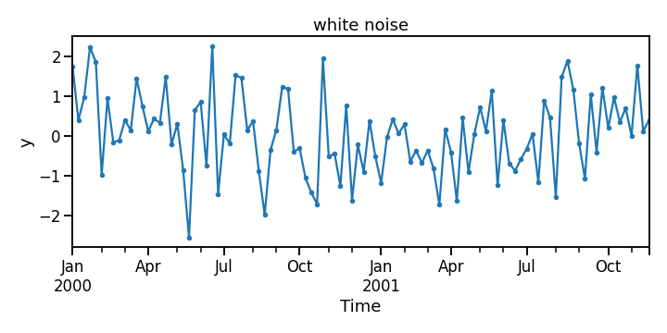
White noise
Let’s generate a time series 𝑦_{𝑡} by taking a random sample from any distribution of our choice (e.g., Normal distribution with zero mean and unit variance aka 𝑁(0,1)) at each time step 𝑡 .
Each value of 𝑦_{𝑡} is identically and independently distributed. There is no correlation between any two points in time. This is called white noise.

Slide 33
White noise
If we sample from 𝑁(0,1) then it is known as Gaussian white noise.
It is common to see this written as: 𝑦_{𝑡} = 𝜖_{𝑡} where 𝜖_{𝑡} ~ 𝑁(0,1)

Slide 34
White noise
White noise has no predictive information in past values as there is no correlation at any two points in time.
It is useful to see how the tools we introduce later in the course behave when a time series is just white noise or contains white noise.

Slide 35
White noise
An important application of white noise is in the analysis of the residuals of a forecast or time series decomposition.
The residuals are the difference between the actuals, y_{t}, and estimated values, 𝑦-_{𝑡}, obtained through a forecast or time series decomposition.

Slide 36
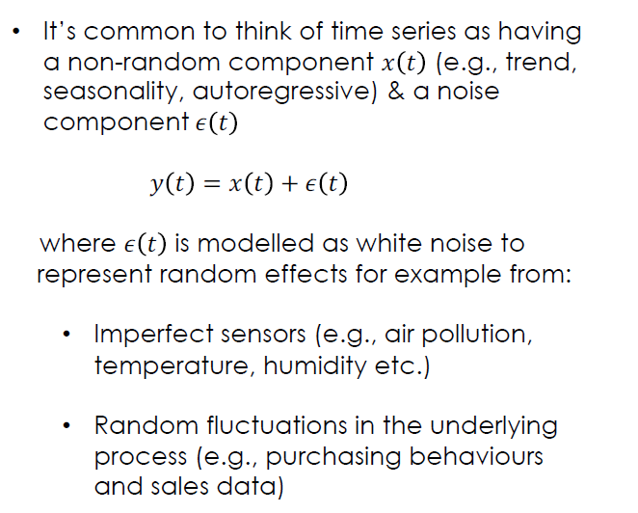
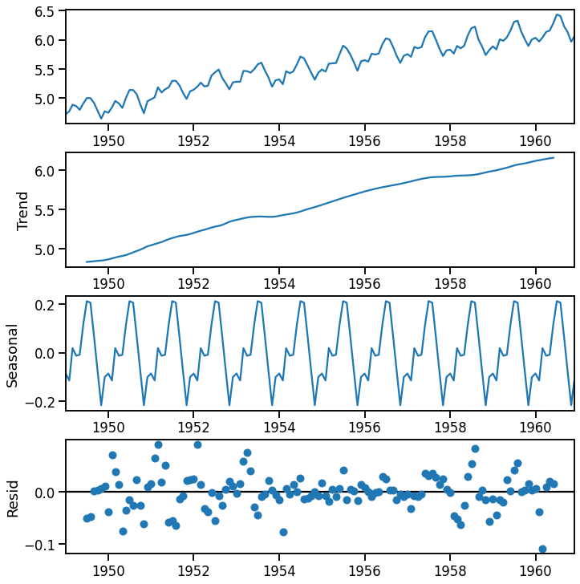
White noise applied to residuals
Air passengers
y
Time

Slide 37
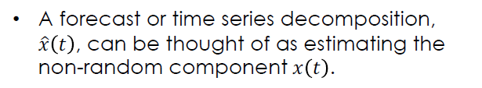
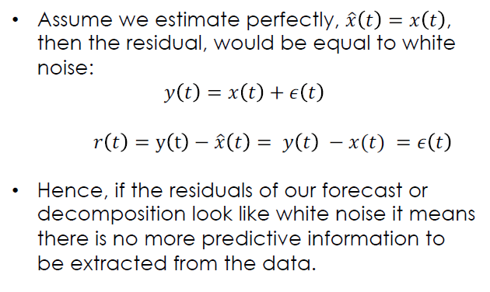
White noise applied to residuals
Air passengers
y
Time

Slide 38
White noise applied to residuals
Air passengers
Some simple checks to see if your residuals
are like white noise:
y
Mean is zero.
Mean and variance don’t change over time (implies no trend or seasonality in residuals).
No autocorrelation. This means that there is no correlation between a time point and any other in the past (we discuss this in a lot more detail little later).
Time

Slide 39
White noise applied to residuals
Air passengers
This decomposition produces residuals
which:
have zero mean.
the mean doesn’t change in time.
the variance does change in time.
y
This means that there is still some non white noise component left in the time series which could be caused by:
imperfect extraction of trend and seasonality.
an additional component exists which is not caught by trend or seasonality (e.g., an autoregressive component).
Time

Slide 40
A white noise time series is one generated by repeatedly sampling from any distribution where each sample is independent.
White noise has no correlation between any two time points. Therefore, past values cannot be used to predict the future.
Summary
If the residuals of a decomposition or forecast look like white noise it means there is no more information left to extract and we did a good job!
13

Slide 41
What is a Random Walk?
A random walk is a statistical process that describes a path consisting of a series of random steps.
It is a simple model of randomness often used in various fields such as finance, physics, economics, and biology.
In a random walk, each step is determined by a random process, and the position of the "walker" (which could represent a stock price, a particle, or any other variable) at any point in time depends on the sum of all previous steps.
Characteristics of a Random Walk:
Start Point: The process usually starts from a given initial position.
Step Size: Each step is typically of the same size but can be either positive (moving forward) or negative (moving backward).
Direction: The direction of each step is random, meaning that it can move either up or down with equal probability.
No Memory: The direction of each step is independent of previous steps (the process has no memory).

Slide 42
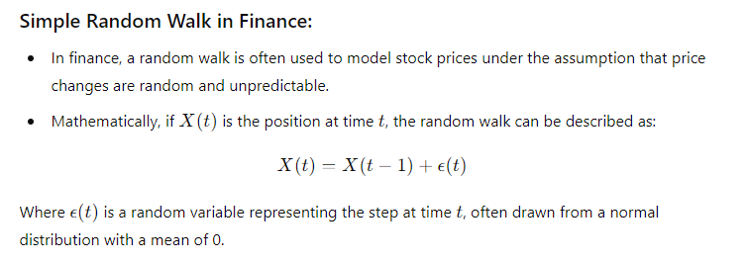
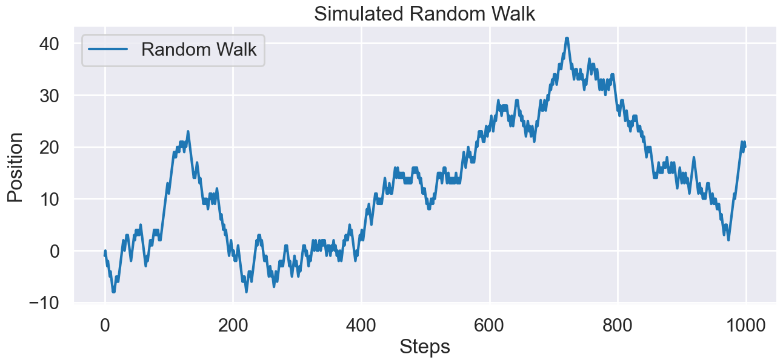
What is a Random Walk?

Slide 43
Additive and multiplicative decompositions
Time series decomposition
1

Slide 44

Contents
INTRODUCE IDEA OF ADDITIVE AND MULTIPLICATIVE DECOMPOSITIONS
DISCUSS WHEN TO USE AN ADDITIVE OR MULTIPLICATIVE DECOMPOSITIONS
2

Slide 45
Time series decomposition
Aim: Decompose a time series into components
Choice / assumption:
y(t) = trend(t) x seasonal(t) x residual(t) y(t) = trend(t) + seasonal(t) + residual(t)
How to choose?
Domain knowledge around data generating process
Looking at certain behaviours of the time series

Slide 46
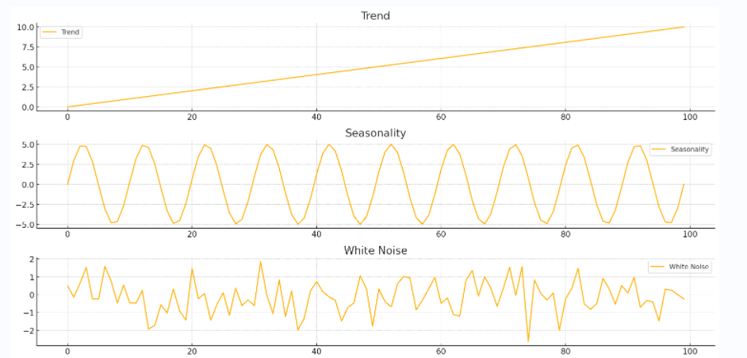
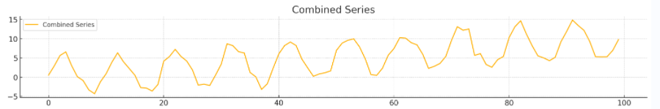

Slide 47
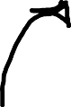
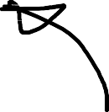
Multiplicative decomposition - Example
T-shirt sales of a growing online clothing brand
Visitors to website increasing over time ⇒ 𝑁 𝑡 ∝ exp(𝑎𝑡)
The product has seasonal demand. Each customer has higher probability, 𝑝 𝑡 , of purchasing during summer then winter
sales 𝑡 ∝ 𝑁 𝑡 × 𝑝 𝑡
Long term trend
yearly seasonality

Slide 48
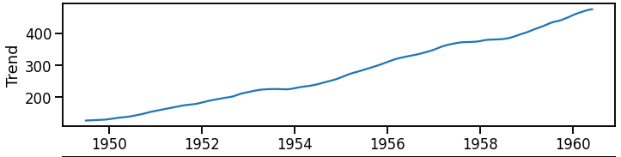
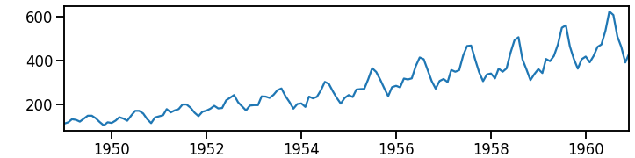
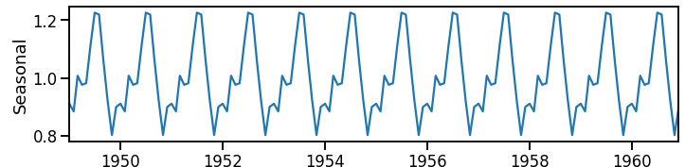
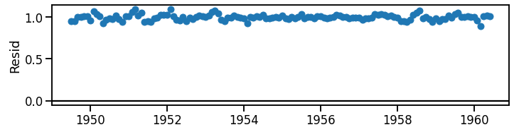
Multiplicative decomposition
Note: The magnitude of the seasonal fluctuations is proportional to the level the time series
x
=
x
the amplitude or the extent of the oscillations in the seasonal component of the time series.

Slide 49
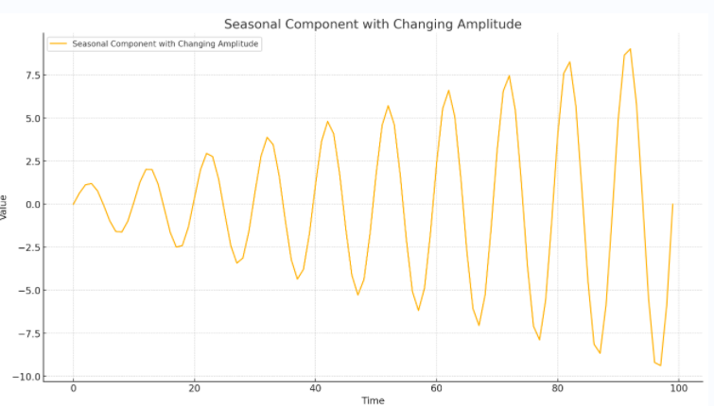
Multiplicative Seasonality-Amplitude

Slide 50
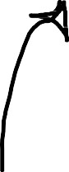
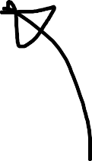
Additive decomposition - Example
Air pollution on a particular road, pollution 𝑡
There is some background level of air pollution, 𝐵(𝑡)
Traffic from vehicles can add air pollution, 𝑇 𝑡
Traffic is busier during peak hours, hence, there is a daily seasonality
So we expect: pollution 𝑡 ∝ 𝐵 𝑡 + 𝑇 𝑡
Long term trend
Daily seasonality

Slide 51
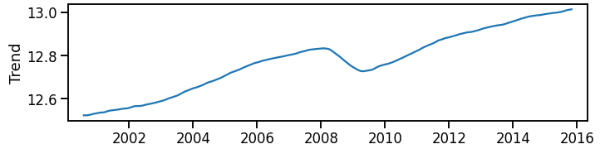
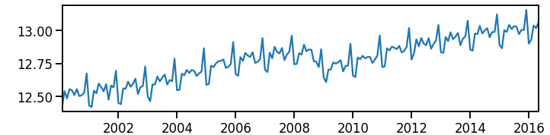
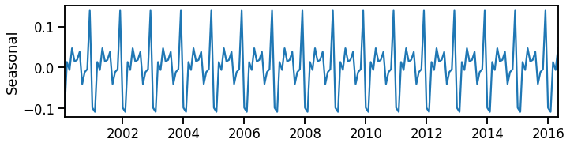
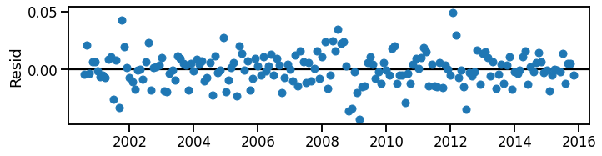
Additive decomposition
Note: The magnitude of the seasonal fluctuations does not change with the level of the time series
+
=
+

Slide 52
Additive/Multiplicative
Additive Scenario: If the sales of a product increase linearly over time, but the seasonal fluctuations remain the same (e.g., a fixed increase in sales every holiday season regardless of the overall trend), an additive model is appropriate.
Multiplicative Scenario: If the sales of a product not only increase over time but also have seasonal fluctuations that get larger as the sales level increases (e.g., a higher increase in sales every holiday season as the overall sales level grows), a multiplicative model is appropriate.
Additive Seasonal Fluctuations: The magnitude of the seasonal effect does not change with the trend. For example, a constant increase or decrease regardless of the overall sales level.
Multiplicative Seasonal Fluctuations: The magnitude of the seasonal effect changes proportionally with the trend. For example, higher sales spikes during peak seasons as the overall sales level increases.

Slide 53
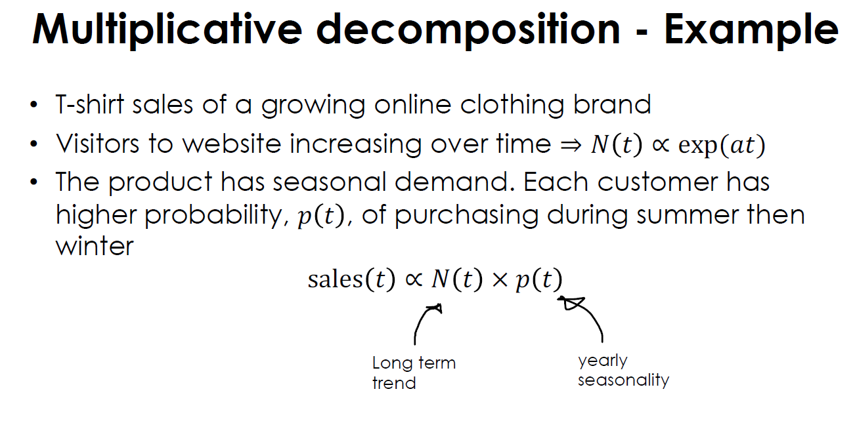

Slide 54
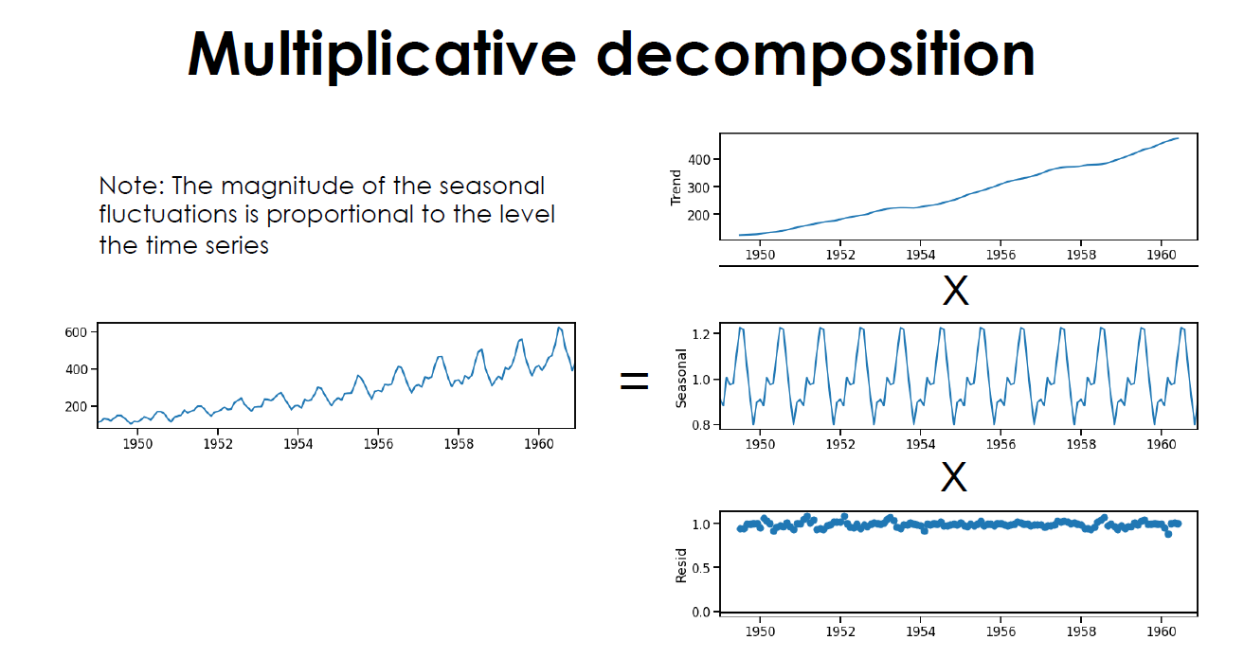

Slide 55
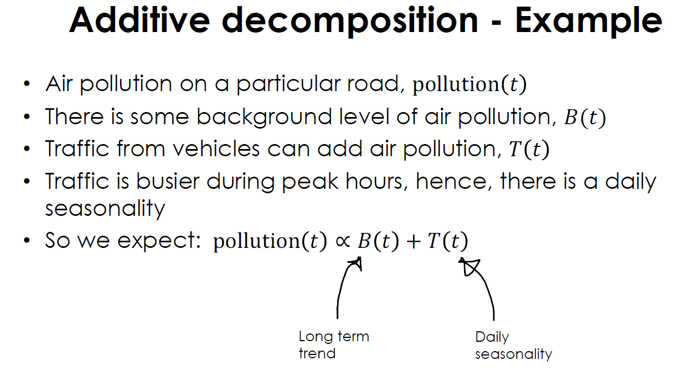

Slide 56
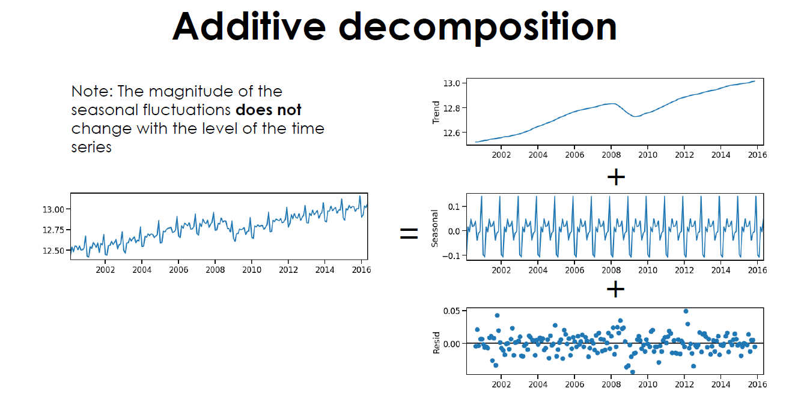

Slide 57
Additive/Multiplicative
Additive Model: Used when variations around the trend line are roughly constant in size.
Multiplicative Model: Used when variations increase or decrease with the trend. This often aligns with real-world scenarios where growth accelerates or decelerates, and seasonal effects compound over time.
Fitness App Revenue: If the number of active users grows and seasonal engagement patterns amplify this growth, the relationship is multiplicative. The effect of a busy New Year period would be larger as the user base grows.
T-shirt Sales: If the number of website visitors increases exponentially and the probability of purchase is higher in summer, the increase in visitors and their heightened probability to purchase in peak seasons will compound, justifying a multiplicative relationship.

Slide 58
Additive
1. Monthly Website Traffic for a Blog
Trend: The blog's monthly traffic increases gradually as it gains more followers.
Seasonality: There is a periodic increase in traffic during specific events or holidays when more content is posted.
Noise: Random variations in daily traffic.
2. Quarterly Sales of a Product
Trend: The product's sales are growing steadily due to a successful marketing campaign.
Seasonality: Sales increase during specific quarters (e.g., Q4 holiday season).
Noise: Random factors affecting sales, such as economic conditions or supply issues.
3. Daily Temperature in a City
Trend: There might be a slow increase in temperature over the years due to climate change.
Seasonality: Daily temperatures vary with the seasons (warmer in summer, cooler in winter).
Noise: Daily fluctuations due to weather patterns

Slide 59

Cyclic Time Series
A cyclic time series is characterized by patterns that repeat at irregular intervals, often influenced by external factors like economic conditions, market cycles, or natural phenomena.
These cycles can last longer than a year and are typically more complex than simple seasonality, which occurs at regular, predictable intervals.
A cyclic pattern exists when data exhibit rises and falls that are not of fixed period. The duration of these fluctuations is usually of at least 2 years.
Think of business cycles which usually last several years, but where the length of the current cycle is unknown beforehand.

Slide 60


Cyclic Time Series
The plot shows the famous Canadian lynx data – the number of lynx trapped each year in the McKenzie river district of northwest Canada (1821-1934). These show clear aperiodic population cycles of approximately 10 years. The cycles are not of fixed length – some last 8 or 9 years and others last longer than 10 years.

Slide 61
Cyclic Time Series
Characteristics of Cyclic Time Series:
Irregular Intervals: The cycles do not follow a fixed period.
External Influence: Often driven by external factors rather than inherent seasonal patterns.
Longer Duration: Cycles can span several years.
Economic Business Cycles
Description: Economic indicators like GDP, unemployment rates, and stock market indices show cyclical patterns of growth and recession.
Cycle Duration: Typically spans several years.
Influences: Driven by factors such as government policies, technological changes, and global events.

Slide 62
Cyclic Time Series
Commodity Prices
Description: Prices of commodities like oil, gold, and agricultural products exhibit cyclical behavior due to changes in supply and demand.
Cycle Duration: Can range from a few years to decades.
Influences: Influenced by geopolitical events, market speculation, and production levels.
Real Estate Market Cycles
Description: Housing prices and real estate investments follow cycles of boom and bust.
Cycle Duration: Typically spans 7-10 years.
Influences: Affected by interest rates, economic conditions, and demographic shifts.

Slide 63
Cyclic Time Series
Commodity Prices
Description: Prices of commodities like oil, gold, and agricultural products exhibit cyclical behavior due to changes in supply and demand.
Cycle Duration: Can range from a few years to decades.
Influences: Influenced by geopolitical events, market speculation, and production levels.
Real Estate Market Cycles
Description: Housing prices and real estate investments follow cycles of boom and bust.
Cycle Duration: Typically spans 7-10 years.
Influences: Affected by interest rates, economic conditions, and demographic shifts.

Slide 64
Cyclic Time Series
Example: Global Wheat Prices
Impact: Both Russia and Ukraine are major exporters of wheat. The conflict has disrupted wheat production and export, leading to fluctuations in global wheat prices.
Cycles: The price cycles could be driven by the ongoing nature of the conflict, sanctions, export bans, and changes in agricultural output.
Imagine a plot showing monthly global wheat prices over several years. You might see the following pattern:
Rising Prices: During periods of escalated conflict or new sanctions, wheat prices spike due to reduced supply.
Falling Prices: During periods of de-escalation or successful harvests elsewhere, prices might fall.
Irregular Cycles: These peaks and troughs don’t occur at regular intervals, reflecting the unpredictable nature of the conflict.
This example illustrates how external, geopolitical events can induce cyclic patterns in economic data

Slide 65
Time series can be decomposed into a multiplicative or additive decomposition/model
Summary
If the seasonal variation is proportional to the level of the time series it would indicate a multiplicative decomposition
8

Slide 66
Log transform
Time series decomposition
1

Slide 67
Contents
LOG TRANSFORM
DISCUSS WHEN TO USE IT
2

Slide 68


Log transform

Slide 69
Converting multiplicative to additive
A multiplicative decomposition can be converted into an additive decomposition by taking the log of the target y(t).
Take the log of y(t) for the multiplicative case:
y(t) = trend(t) x seasonal(t) x residual(t)
log y(t) = log (trend(t) x seasonal(t) x residual(t))
log y(t) = log trend(t) + log seasonal(t) + log residual(t)
If underlying time series is multiplicative then log of series is additive.
Provides intuition as to why log transform can stabilize the variance.

Slide 70


Converting multiplicative to additive
Log(y)
Multiplicative
Additive

Slide 71
Converting multiplicative to additive
This technique is useful because some time series decomposition methods (e.g., STL decomposition) and forecasting methods only handle the additive case.
So we require log transforming the data first before using certain decomposition and forecasting methods.

Slide 72
The log transform can be used to stabilize the variance of a time series.
Summary
The log transform can convert a multiplicative time series to an additive one.
7

Slide 73
Box Cox transform
Time series decomposition
1

Slide 74
Contents
BOX COX TRANSFORM
DISCUSS WHEN TO USE IT
2

Slide 75

Motivation
Some forecasting & decomposition methods perform better if the variance of the time series does not change with the level of the time series (e.g., ARIMA).
The log transform does not always stabilize the variance of a time series. It depends on the time series.
The Box Cox transform is a more general transform that can be used to stabilize the variance of a time series.

Slide 76

What kind of transforms are useful?

Slide 77

What kind of transforms are useful?
What kind of transform of our time series, 𝑓(𝑦_{𝑡}), could be useful in stabilising the variance? It depends on the time series.
To stabilise the variance we want the transformation to remove the interaction between the trend and any seasonality or noise term so we can write them additively: 𝑓 𝑦_{𝑡} = 𝑇_{𝑡} + 𝑆_{𝑡} + 𝑅_{𝑡}
In our toy time series we had: 𝑦_{𝑡} = (sin²
2𝜋𝑡
+𝑡)²
10
We can think of this as: 𝑦_{𝑡} = 𝑆_{𝑡} + 𝑇_{𝑡} ²
A better transform would be using the square root!
1
𝑦² = 𝑆_{𝑡} + 𝑇_{𝑡}
𝑡
Now the variance does not change with the trend.

Slide 78

What kind of transforms are useful?
1
𝑦² is an example of what is called a power transform. We raised the original variable to some power.
A more general way of writing power transforms are: 𝑦^{𝜆}
Sometimes a power transform can be better at stabilizing the variance than a log transform. It depends on the time series.
The Box Cox transform combines both a log transform and a power transform.

Slide 79

Box Cox transform

Slide 80

Box Cox transform
A good value for 𝜆 makes the variance the same size across the time series.
How do we pick a good value for 𝜆?
Try different 𝜆, plot the data and check visually that the variance is nearly constant.
Use a method that automatically selects 𝜆
that optimizes on some criteria.

Slide 81


Box Cox transform
A good value for 𝜆 makes the variance the same size across the time series.
How do we pick a good value for 𝜆?
Try different 𝜆, plot the data and check visually that the variance is nearly constant.
Use a method that automatically selects 𝜆
that optimizes on some criteria.
Maximum likelihood (MLE): Picks 𝜆 that makes transformed data look the most normally distributed.
Guerrero: Picks 𝜆 that tries to make the variance constant across the time series.

Slide 82



Box Cox implementation in Scipy

Slide 83


Box Cox implementation in sktime

Slide 84
Forecasting and decomposition methods sometimes work better if the variance is stable across the whole time series.
Log and power transforms can help stabilize the variance across the time series.
Summary
A Box Cox transform combines the log and power transform into a single method with a parameter 𝜆.
The best 𝜆 is the one that makes the variance stable across the time series.
Multiple methods exist to automatically select the best
𝜆, however, they don’t always agree and manual sense checking is advised.
12

Slide 85
Forecasting and decomposition methods sometimes work better if the variance is stable across the whole time series.
Summary
A Box Cox transform can stabilize the variance, but we need to pick a good value for the parameter 𝜆.
16

Slide 86
Moving averages
Time series decomposition
1

Slide 87
Contents
INTRODUCE MOVING AVERAGES
PRACTICAL CONSIDERATIONS
2

Slide 88
Moving average example
Consider window of size 3
Date | 𝒚 | 3-MA
2020-02-12 | 23
2020-02-13 | 30
2020-02-14 | 70
2020-02-15 | 30
2020-02-16 | 25
2020-02-17 | 22

Slide 89
Moving average example
Consider window of size 3
Date | 𝒚 | 3-MA
2020-02-12 | 23
2020-02-13 | 30
2020-02-14 | 70
2020-02-15 | 30
2020-02-16 | 25
2020-02-17 | 22

Slide 90
Moving average example
Consider window of size 3
Compute at center of window
Compute mean
Date | 𝒚 | 3-MA
2020-02-12 | 23
2020-02-13 | 30
2020-02-14 | 70
2020-02-15 | 30
2020-02-16 | 25
2020-02-17 | 22

Slide 91
Moving average example
Consider window of size 3
Compute at center of window
Compute mean
Date | 𝒚 | 3-MA
2020-02-12 | 23
2020-02-13 | 30 | 41.0
2020-02-14 | 70
2020-02-15 | 30
2020-02-16 | 25
2020-02-17 | 22

Slide 92
Moving average example
Consider window of size 3
Compute at center of window
Compute mean
Move window and iterate
Date | 𝒚 | 3-MA
2020-02-12 | 23
2020-02-13 | 30 | 41.0
2020-02-14 | 70
2020-02-15 | 30
2020-02-16 | 25
2020-02-17 | 22

Slide 93
Moving average example
Consider window of size 3
Compute at center of window
Compute mean
Move window and iterate
Date | 𝒚 | 3-MA
2020-02-12 | 23
2020-02-13 | 30 | 41.0
2020-02-14 | 70 | 43.3
2020-02-15 | 30
2020-02-16 | 25
2020-02-17 | 22

Slide 94
Moving average example
Consider window of size 3
Compute at center of window
Compute mean
Move window and iterate
Date | 𝒚 | 3-MA
2020-02-12 | 23
2020-02-13 | 30 | 41.0
2020-02-14 | 70 | 43.3
2020-02-15 | 30 | 41.7
2020-02-16 | 25
2020-02-17 | 22

Slide 95
Moving average example
Consider window of size 3
Compute at center of window
Compute mean
Move window and iterate
Date | 𝒚 | 3-MA
2020-02-12 | 23
2020-02-13 | 30 | 41.0
2020-02-14 | 70 | 43.3
2020-02-15 | 30 | 41.7
2020-02-16 | 25 | 25.7
2020-02-17 | 22

Slide 96
Moving average example
Consider window of size 3
Compute at center of window
Compute mean
Move window and iterate
3-MA is a shorter time series
Date | 𝒚 | 3-MA
2020-02-12 | 23
2020-02-13 | 30 | 41.0
2020-02-14 | 70 | 43.3
2020-02-15 | 30 | 41.7
2020-02-16 | 25 | 25.7
2020-02-17 | 22

Slide 97
Moving average example
Consider window of size 3
Compute at center of window
Compute mean
Move window and iterate
3-MA is a shorter time series
Moving Average Generates a
time series which is shorter
than original
Date | 𝒚 | 3-MA
2020-02-12 | 23 | NaN
2020-02-13 | 30 | 41.0
2020-02-14 | 70 | 43.3
2020-02-15 | 30 | 41.7
2020-02-16 | 25 | 25.7
2020-02-17 | 22 | NaN

Slide 98

Moving average

Slide 99




Moving Average

Slide 100


Moving Average

Slide 101

Even window size
Often the window size is selected to be the same as the seasonality to smooth out seasonal variation
Example: Monthly data, yearly seasonality T=12
With an even window, where do we compute the mean value?
There is no obvious centre for us to place
2020
2020
2020
2021
2021
2021

Slide 102

Even window size
Often the window size is selected to be the same as the seasonality to smooth out seasonal variation
Example: Monthly data, yearly seasonality T=12
With an even window, where do we compute the mean value?
There is no obvious centre for us to place
An odd window size would double count specific months
2020
2020
2020
2021
2021
2021

Slide 103
Even window size
Problem: Where should the average value go as there is no obvious centre?
We could think of the value belonging half way between two rows
Time index | 𝒚 | 4-MA
1 | 23
2 | 30
3 | 70
4 | 30
5 | 25
6 | 22

Slide 104
Even window size
Time index | 𝒚 | 4-MA
1 | 23
1.5
2 | 30
2.5
3 | 70
3.5
4 | 30
4.5
5 | 25
5.5
6 | 22
Problem: Where should the average value go as there is no obvious centre?
We could think of the value belonging half way between two rows

Slide 105
Even window size
Time index | 𝒚 | 4-MA
1 | 23
1.5
2 | 30
2.5 |  | 38.25
3 | 70
3.5
4 | 30
4.5
5 | 25
5.5
6 | 22
Problem: Where should the average value go as there is no obvious centre?
We could think of the value belonging half way between two rows

Slide 106
Even window size
Time index | 𝒚 | 4-MA
1 | 23
1.5
2 | 30
2.5 |  | 38.25
3 | 70
3.5 |  | 38.75
4 | 30
4.5
5 | 25
5.5
6 | 22
Problem: Where should the average value go as there is no obvious centre?
We could think of the value belonging half way between two rows

Slide 107
Even window size
Time index | 𝒚 | 4-MA
1 | 23
1.5
2 | 30
2.5 |  | 38.25
3 | 70
3.5 |  | 38.75
4 | 30
4.5 |  | 36.75
5 | 25
5.5
6 | 22
Problem: Where should the average value go as there is no obvious centre?
We could think of the value belonging half way between two rows

Slide 108
Even window size
Time index | 𝒚 | 4-MA
1 | 23
1.5
2 | 30
2.5 |  | 38.25
3 | 70
3.5 |  | 38.75
4 | 30
4.5 |  | 36.75
5 | 25
5.5
6 | 22
Problem: Where should the average value go as there is no obvious centre?
We could think of the value belonging half way between two rows
Apply another moving average of window size 2 to the 4-MA (aka 2 X 4- MA)

Slide 109
Even window size
Time index | 𝒚 | 4-MA | 2 X 4- MA
1 | 23
1.5
2 | 30
2.5 |  | 38.25
3 | 70
3.5 |  | 38.75
4 | 30
4.5 |  | 36.75
5 | 25
5.5
6 | 22
Problem: Where should the average value go as there is no obvious centre?
We could think of the value belonging half way between two rows
Apply another moving average of window size 2 to the 4-MA (aka 2 X 4- MA)

Slide 110
Even window size
Time index | 𝒚 | 4-MA | 2 X 4- MA
1 | 23
1.5
2 | 30
2.5 |  | 38.25
3 | 70 |  | 38.5
3.5 |  | 38.75
4 | 30
4.5 |  | 36.75
5 | 25
5.5
6 | 22
Problem: Where should the average value go as there is no obvious centre?
We could think of the value belonging half way between two rows
Apply another moving average of window size 2 to the 4-MA (aka 2 X 4- MA)

Slide 111
Even window size
Time index | 𝒚 | 4-MA | 2 X 4- MA
1 | 23
1.5
2 | 30
2.5 |  | 38.25
3 | 70 |  | 38.5
3.5 |  | 38.75
4 | 30 |  | 37.75
4.5 |  | 36.75
5 | 25
5.5
6 | 22
Problem: Where should the average value go as there is no obvious centre?
We could think of the value belonging half way between two rows
Apply another moving average of window size 2 to the 4-MA (aka 2 X 4- MA)

Slide 112


Even window size
Time index | 𝒚 | 4-MA | 2 X 4- MA
1 | 23
1.5
2 | 30
2.5 |  | 38.25
3 | 70 |  | 38.5
3.5 |  | 38.75
4 | 30 |  | 37.75
4.5 |  | 36.75
5 | 25
5.5
6 | 22
This gives a symmetric window where the weights still sum to one
𝑧 = ¹ ¹ 𝑦
+ 𝑦 + 𝑦 + 𝑦
+ ¹ 𝑦
+ 𝑦 + 𝑦 + 𝑦
𝑡
𝑡−2 𝑡−1 𝑡 𝑡+1
𝑡−1
𝑡
𝑡+1
𝑡+2
2 4 4
^{= 1 𝑦}𝑡−2 ^{+ 1 𝑦}𝑡−1 ^{+ 1 𝑦}𝑡 ^{+ 1 𝑦}𝑡+1 ^{+ 1 𝑦}𝑡+2
8 4 4 4 8
The edges of the window share half the weight, this mitigates the double counting discussed earlier

Slide 113
Even window size
Time index | 𝒚 | 4-MA | 2 X 4- MA
1 | 23 |  | NaN
1.5
2 | 30 |  | NaN
2.5 |  | 38.25
3 | 70 |  | 38.5
3.5 |  | 38.75
4 | 30 |  | 37.75
4.5 |  | 36.75
5 | 25 |  | NaN
5.5
6 | 22 |  | NaN
This gives a symmetric window where the weights still sum to one
𝑧 = ¹ ¹ 𝑦
+ 𝑦 + 𝑦 + 𝑦
+ ¹ 𝑦
+ 𝑦 + 𝑦 + 𝑦
𝑡
𝑡−2 𝑡−1 𝑡 𝑡+1
𝑡−1
𝑡
𝑡+1
𝑡+2
2 4 4
^{= 1 𝑦}𝑡−2 ^{+ 1 𝑦}𝑡−1 ^{+ 1 𝑦}𝑡 ^{+ 1 𝑦}𝑡+1 ^{+ 1 𝑦}𝑡+2
8 4 4 4 8
The edges of the window share half the weight, this mitigates the double counting discussed earlier

Slide 114
Even window size
Time index | 𝒚 | 4-MA | 2 X 4- MA
1 | 23 |  | NaN
1.5
2 | 30 |  | NaN
2.5 |  | 38.25
3 | 70 |  | 38.5
3.5 |  | 38.75
4 | 30 |  | 37.75
4.5 |  | 36.75
5 | 25 |  | NaN
5.5
6 | 22 |  | NaN
Any even order centered MA can be dealt with by applying an additional 2-MA
Example: If we wanted m=6 we can compute a 2 x 6-MA to get:
^{z}t ^{= 1 𝑦}𝑡−3 ^{+ 1 𝑦}𝑡−2 ^{+ 1 𝑦}𝑡−1 ^{+ 1 𝑦}𝑡 ^{+ 1 𝑦}𝑡+1 ^{+ 1 𝑦}𝑡+2 ^{+ 1 𝑦}𝑡+3
12 6 6 6 6 6 12

Slide 115



2MA of 4MA
$$z_{t}=38.5=\frac{38.25+38.75}{2}$$
$=\frac{\frac{23+30+70+30}{4}+ \frac{30+70+30+25}{4}}{2}$
$z_{t}=38.5$ corresponding $y_{t}=70 y_{t−1}=30, y_{t−2}=23,y_{t+1}=30,y_{t+2}=25$

Slide 116

Trend using Moving average

Slide 117

Trend using Moving average

Slide 118

Trend using Moving average

Slide 119

Moving average implementation

Slide 120

Moving average implementation

Slide 121

Moving average implementation

Slide 122
Moving average computes the mean of the data over a window across a time series
The window size, m, defines the order of the moving average denoted as m-MA
Summary
An even ordered centered moving average can be obtained by applying an additional 2-MA
30

Slide 123

Moving average

Slide 124

Limitations

Slide 125

Limitations

Slide 126

Limitations

Slide 127


Slide 128
LOWESS (Theory)
Time series decomposition
1

Slide 129

Contents
LOWESS FOR TREND EXTRACTION
DISCUSS LIMITATIONS
2

Slide 130

How can we extract the trend?
Extract-Trend- the change in the base line of the time series

Slide 131

Classical Decomposition

Slide 132


Slide 133


Slide 134


Slide 135


Slide 136




Slide 137

Seasonal index

Slide 138

Seasonal index

Slide 139

Seasonal index

Slide 140
Limitations of moving averages
Not robust to outliers
Missing data at the edges
Over-smooths rapid changes in trend
Order of moving average was set by seasonal period(difficult to set order of moving averages)
If you do not know the seasonality of time series you have to manually select the order which balances between under smoothing and over smoothing
How does LOWESS overcome this
Date | 𝒚 | mean
2020-02-12 | 23
2020-02-13 | 30 | 41.0
2020-02-14 | 70 | 43.3
2020-02-15 | 30 | 41.7
2020-02-16 | 25 | 25.7
2020-02-17 | 22

Slide 141

LOWESS
Cleveland, William S. "Robust locally weighted regression and smoothing scatterplots." Journal of the American statistical association 74.368 (1979): 829-836.
5

Slide 142
LOWESS
LOWESS, also known as LOESS (Locally Estimated Scatterplot Smoothing), is a non-parametric regression method used to fit a smooth curve through a scatterplot of data points.
This technique is particularly useful for capturing the underlying trend in the presence of noisy data.
Parametric models come with assumptions about the distribution and relationship between variables (e.g., linearity, normality).
Non-parametric methods make fewer assumptions, reducing the risk of model misspecification and potential biases.
Lowess relies purely on the data to determine the form of the model. It uses local information around each point to fit the curve, making it highly responsive to the actual data distribution and structure.
Cleveland, William S. "Robust locally weighted regression and smoothing scatterplots." Journal of the American statistical association 74.368 (1979): 829-836.
5

Slide 143

LOWESS
LOWESS is a very good way of extracting trend from times series-read more highly recommend paper
Cleveland, William S. "Robust locally weighted regression and smoothing scatterplots." Journal of the American statistical association 74.368 (1979): 829-836.
5

Slide 144

The main idea
fraction f is a parameter to set – 10% 20% etc. around selected x (area of interest)
Weighted robust linear regression is a method that combines weighted least squares with robust estimation techniques to handle outliers and heteroscedasticity in the data effectively

Slide 145

LOWESS

Slide 146

LOWESS
At 𝑥 = 50 consider a window which captures a fraction 𝑓 of the data

Slide 147

LOWESS
At 𝑥 = 50 consider a window which captures a fraction 𝑓 of the data
𝑓 = 0.33

Slide 148
LOWESS
Fit a weighted robust linear regression to this subset of the data

Slide 149
LOWESS
Fit a weighted robust linear regression to this subset of the data
More weights given to data points which are closer to point of interest here x = 50 than that is data that is further away form point of interests

Slide 150

Weight function for LOWESS
More weights around 0 and points near to 0

Slide 151







Tricube plot
$$x_{i}=50 ,N=100,f=0.33$$
$$\frac{1}{Nf}\left(x−x_{i}\right)=\frac{1}{50×0.33}\left(x−50\right)$$
$=\frac{1}{16.5}$ $\left(x−50\right)$
$=\frac{x−50}{16.5}$
$w^{∗}(\frac{x−50}{16.5}$ )$={\left(1−{\left|\frac{x−50}{16.5}\right|}^{3}\right)}^{3} ,\left|\frac{x−50}{16.5}\right|<1$
0 $\left|\frac{x−50}{16.5}\right|≥1$
$$33.5<x<66.5$$

Slide 152

LOWESS
Fit a weighted robust linear regression to this subset of the data

Slide 153

LOWESS
Fit a weighted robust linear regression to this subset of the data

Slide 154














Robust regression
Fit linear regression multiple times. On each iteration re-weight the data by residuals of the previous fit such that less weight is given to high residual data points.
Outliers produce large residuals. Hence, by re-weighting the data we can minimize their impact on the fit. High residual will be given less weight and low residual will be given weight close to 1 these weights are obtained using bicubic function
y
x

Slide 155

Robust regression

Slide 156
LOWESS
Fit a weighted robust linear regression to this subset of the data

Slide 157

LOWESS
Fit a weighted robust linear regression to this subset of the data

Slide 158
LOWESS
LOWESS curve at 𝑥 is given by the weighted robust linear regression

Slide 159

LOWESS
LOWESS curve at 𝑥 is given by the weighted robust linear regression

Slide 160
LOWESS
Evaluate the same process across many 𝑥 values to obtain a smooth fit
New value at x = 50 is the values given by LOWESS line

Slide 161

LOWESS
Evaluate the same process across many 𝑥 values to obtain a smooth fit

Slide 162

LOWESS
Evaluate the same process across many 𝑥 values to obtain a smooth fit

Slide 163

LOWESS
Evaluate the same process across many 𝑥 values to obtain a smooth fit

Slide 164


Slide 165

LOWESS
Evaluate the same process across many 𝑥 values to obtain a smooth fit

Slide 166

LOWESS
The LOWESS fit can be used as an estimate of the trend of a time series

Slide 167

Parameters
𝑓: Fraction of data for window size
Determines smoothness of the fit
Good value depends on data
Trying to have as smooth a fit without distorting patterns in the data
Can set visually or using cross-validation
𝑖: Number of iterations for robust regression
Ensures robustness to outliers
Typically set to 2 or 3 [1]
[1] Cleveland, William S. "Robust locally weighted regression and smoothing scatterplots." Journal of the American statistical association 74.368 (1979): 829-836.
9

Slide 168


Implementation

Slide 169
Discussion
Pros
Robust to outliers
No missing data at the edges
Interpretable
A good 𝑓 will avoid over- smoothing the data
No assumptions made about the data
Cons
Slow to fit on large datasets
Requires access to entire dataset to evaluate curve at any point
Selecting 𝑓 often requires manual inspection

Slide 170
LOWESS is a method to fit a smooth curve to a scatter plot
Summary
LOWESS can be used to extract the trend term in a time series
12

Slide 171
LOWESS vs LOESS
Time series decomposition
1

Slide 172


LOWESS vs LOESS
LOWESS
Locally weighted scatterplot smoothing
W. Cleveland 1979
LOESS
Locally estimated scatterplot smoothing
W. Cleveland & S. Devlin 1988
Cleveland, William S. "Robust locally weighted regression and smoothing scatterplots." Journal of the American statistical association 74.368 (1979): 829-836.
Cleveland, William S., and Susan J. Devlin. "Locally weighted regression: an approach to regression analysis by local fitting." Journal of the American statistical association 83.403 (1988): 596-610.
See https://stats.stackexchange.com/questions/161069/difference-between-loess-and-lowess for a detailed discussion.

Slide 173
LOWESS vs LOESS
LOWESS
Locally weighted scatterplot smoothing
W. Cleveland 1979
LOESS
Locally estimated scatterplot smoothing
W. Cleveland & S. Devlin 1988
See https://stats.stackexchange.com/questions/161069/difference-between-loess-and-lowess for a detailed discussion.

Slide 174
LOWESS vs LOESS
LOWESS
Locally weighted scatterplot smoothing
W. Cleveland 1979
Similarity
Fits a locally weighted curve using regression.
Uses tri-cubic weight function.
Uses bi-square weights for robustness.
LOESS
Locally estimated scatterplot smoothing
W. Cleveland & S. Devlin 1988
Similarity
Fits a locally weighted curve using regression.
Uses tri-cubic weight function.
Uses bi-square weights for robustness (depends on implementation).
See https://stats.stackexchange.com/questions/161069/difference-between-loess-and-lowess for a detailed discussion.

Slide 175
LOWESS and LOESS fit local weighted curves
Tri-cubic function used to give weights in the fit.
A fit is made to a local subset of data.
A bi-square function is used to downweight outliers.

Slide 176
LOWESS vs LOESS
LOWESS
LOESS
Locally weighted scatterplot smoothing
W. Cleveland 1979
Locally estimated scatterplot smoothing
W. Cleveland & S. Devlin 1988
Similarity
Fits a locally weighted curve using regression.
Uses tri-cubic weight function.
Uses bisquare weights for robustness.
Similarity
Fits a locally weighted curve using regression.
Uses tri-cubic weight function.
Uses bi-square weights for robustness (depends on implementation).
Difference
Uses linear regression.
Fits a curve to univariate data (y is 1-D).
Difference
Uses polynomial regression.
Fits a surface to multivariate data (y is N-D).
See https://stats.stackexchange.com/questions/161069/difference-between-loess-and-lowess for a detailed discussion.
6

Slide 177


LOESS fits a local polynomial regression
Previously showed that LOWESS uses a local, robust, and weighted linear regression.
𝑑 = 1
LOESS uses a polynomial regression
𝑦 = 𝛽₀ + 𝛽₁𝑥 + 𝛽₂𝑥² + ⋯ + 𝛽_{𝑑}𝑥^{𝑑}
𝑑 = 2
𝑑: Degree of polynomial to use in LOESS.
Most applications use 𝑑 = 1 and in some rarer cases 𝑑 = 2 or 𝑑 = 0.
𝑑 = 0
7

Slide 178
LOWESS vs LOESS
LOWESS
Locally weighted scatterplot smoothing
W. Cleveland 1979
LOESS
Locally estimated scatterplot smoothing
W. Cleveland & S. Devlin 1988
Similarity
Fits a locally weighted curve using regression
Uses tri-cubic weight function
Uses bisquare weights for robustness
Similarity
Fits a locally weighted curve using regression
Uses tri-cubic weight function
Uses bi-square weights for robustness (depends on implementation)
Difference
Uses linear regression
Fits a curve to univariate data (y is 1-D)
Difference
Uses polynomial regression
Fits a surface to multivariate data (y is N-D)
See https://stats.stackexchange.com/questions/161069/difference-between-loess-and-lowess for a detailed discussion.
8

Slide 179
Robust Regression
$$x_{i}$$ | $$y_{i}$$ | $$\hat{y_{i}}$$ | $$y_{i}−\hat{y_{i}}$$ | $$w_{i}{\left(y_{i}−\hat{y_{i}}\right)}^{2}$$ | $$δ_{i}w_{i}{\left(y_{i}−\hat{y_{i}}\right)}^{2}$$

Slide 180
LOWESS and LOESS fit a curve to local partitions of the data
Summary
LOWESS fits a line and LOESS fits a polynomial
LOWESS only works with 1-D data and LOESS can work with N-D data
9

Slide 181
Seasonal and Trend decomposition using LOESS (STL) - Overview
Time series decomposition
1

Slide 182



Contents
STL TO EXTRACT TREND
STL TO EXTRACT SEASONALITY
DISCUSS PRACTICALITIES
2

Slide 183

STL
Cleveland, Robert B., et al. "STL: A seasonal-trend decomposition." Journal of official statistics 6.1 (1990): 3-73.

Slide 184
The main idea
Assume: y(t) = trend(t) + seasonal(t) + residual(t)
Want a way to calculate each individual component
STL does this using LOESS

Slide 185

The main idea
Outer loop
Compute robustness weights from residuals used by LOESS in inner loop to protect against outliers
Inner loop
Compute estimate of trend(t) and seasonal(t) using LOESS
Compute residuals
residual(t) = y - trend(t) – seasonal(t)

Slide 186
Inner loop summary
ITERATE
1. De-trend the data: y(t) – trend(t). For the first iteration assume trend(t) = 0
Inner loop
2. Extract seasonal(t) using LOESS on a set of time series derived from y_detrend(t) called cycle-subseries.
Compute estimate of trend(t) and seasonal(t) using LOESS
3. Extract trend(t) by subtracting seasonal(t) from y(t) and smoothing using LOESS

Slide 187
Outer loop summary
Outer loop
ITERATE
1. Extract seasonal(t) and trend(t) from inner loop
Inner loop
2. Compute residuals:
y(t) – trend(t) – seasonal(t)
Compute estimate of trend(t) and seasonal(t) using LOESS
3. Compute weights from residuals 𝜌_{𝑡} to pass to LOWESS in the inner loop . This is to down-weight outliers.

Slide 188



Implementation

Slide 189


Example with outliers
Classical decomposition
STL decomposition

Slide 190


Most important parameters
𝑛_{𝑠} = 3
𝑛_{𝑠} (seasonal): Determines smoothness and uniformity of seasonal component. Default value of 7 typically good enough.
𝑛_{𝑠} = 101

Slide 191

Most important parameters
𝑛_{𝑠} = 7
𝑛_{𝑠} (seasonal): Determines smoothness and uniformity of seasonal component. Default value of 7 typically good enough.
𝑛_{𝑝} (period): The seasonal period (e.g., for daily data and weekly seasonality this would be 7). Normally determined by the use case

Slide 192
How to handle multiplicative time series
STL assumes the time series is additive
If time series is multiplicative use log transform to make it additive
log y(t) = log (trend(t) x seasonal(t) x residual(t))
log y(t) = log trend(t) + log seasonal(t) + log residual(t)
Transform back to original scale by taking inverse log transform

Slide 193
STL extracts the seasonality and trend iteratively using LOESS
STL is robust to outliers
Summary
There are two main parameters to set in practice, the remaining default parameters are normally sufficient
The seasonal component can vary in time and is not necessarily periodic
17

Slide 194

Stationary Time Series
Constant Mean: The mean value of the series remains constant over time.
Constant Variance: The variance of the series does not change over time.
.

Slide 195

Stationary Time Series
Time series with trends (varying mean over time), or with seasonality (variations of a specific time frame), are not stationary — the trend and seasonality will affect the value of the time series at different times.
seasonality rules out series (d), (h) and (i). Trends and changing levels rules out series (a), (c), (e), (f) and (i). Increasing variance also rules out (i). That leaves only (b) and (g) as stationary series.

Slide 196
Augmented Dickey-Fuller test.
The Augmented Dickey-Fuller (ADF) test is used to check if a time series is stationary, meaning its statistical properties like mean and variance don't change over time.
Hypotheses:
Null Hypothesis (H₀): The time series has a unit root, meaning it is non-stationary.
Alternative Hypothesis (H₁): The time series is stationary (it does not have a unit root).
you reject the null hypothesis, indicating the series is stationary.

Slide 197



Augmented Dickey-Fuller test.
Conclusion:($p>0.05)$ fail to reject Null)
Since the ADF statistic is not more negative than the critical values at any significance level, and the p-value is quite high (0.8606), we fail to reject the null hypothesis. This indicates that the time series is non-stationary.

Slide 198


Augmented Dickey-Fuller test.
Since the ADF statistic (-4.8083) is more negative than the critical values at all significance levels (1%, 5%, and 10%), and the p-value is extremely low (0.000052) ($p<0.05$), we reject the null hypothesis. This indicates that the time series is stationary. ​

Slide 199
How To make Time series Stationary
Differencing: Subtract the previous observation from the current observation to remove trends or seasonality.
Log Transformation: Apply a logarithm to the series to stabilize variance and reduce trend effects.
Seasonal Differencing: Subtract the value from the same period in the previous cycle (e.g., the value 12 months ago in monthly data).
Decomposition: Break the series into trend, seasonality, and residual components and remove the trend and/or seasonality.
Moving Average: Apply a moving average to smooth out short-term fluctuations and highlight longer-term trends.
Transformation: Apply other mathematical transformations like square root or Box-Cox transformation to stabilize variance.

Slide 200


Differencing
If $y_{t}$ represents the value of the time series at time $t$, the first-order
difference $∆y_{t}$​ is calculated as: $∆y_{t}=y_{t}−y_{t−1}$
The Second order difference $∆^{2}y_{t}=∆y_{t}−∆y_{t−1}$

Slide 201

Differencing
First-order differencing removes a linear trend.
Second-order differencing removes quadratic trends.
Third-order differencing removes cubic trends, and so on.
The goal is to apply enough differencing to achieve stationarity, but without over-differencing, which could introduce unnecessary noise into the series.

Slide 202

Differencing

Slide 203

Differencing

Slide 204

Differencing

Slide 205

Lags
Time(t) | $Y_{t}$ | lag1->$Y_{t−1}$ | lag2->$Y_{t−2}$ | lag3->$Y_{t−3}$
1 | 6 | NA | NA | NA
2 | 4 | 6 | NA | NA
3 | 5 | 4 | 6 | NA
4 | 7 | 5 | 4 | 6
5 | 6 | 7 | 5 | 4
6 | 5 | 6 | 7 | 5
7 | 4 | 5 | 6 | 7
8 | 5 | 4 | 5 | 6
9 | 7 | 5 | 4 | 5
10 | 6 | 7 | 5 | 4

